Slide 1

Natural Language Processing for Email Spam Detection
SRM INSTITUTE OF SCIENCE AND TECHNOLOGY
FACULTY OF ENGINEERING AND TECHNOLOGY
DEPARTMENT OF NETWORKING AND COMMUNICATIONS
Student Reg No: RA2211031010131
Batch ID:
Guide name and Designation: Dr. Asha Abraham (Assistant Professor.)

Slide 2
Abstract
This project implements an email spam detection system using Natural Language Processing (NLP) and machine learning techniques, containerized via Docker for seamless deployment. The system employs a Multinomial Naive Bayes classifier with TF-IDF vectorization, achieving real-time text classification through a Flask-based web interface. The solution demonstrates an end-to-end pipeline from data preprocessing to production deployment, emphasizing DevOps practices through Docker containerization and REST API integration. The web interface provides intuitive user interaction, making spam detection accessible to non-technical users.

Slide 3
Introduction
Email spam remains a significant challenge in digital communication, with 45% of global email traffic classified as spam in 2023 (Statista). Traditional rule-based filters often struggle with evolving spam patterns, necessitating machine learning approaches. This project addresses this need by developing:
An NLP pipeline for text preprocessing
A probabilistic classification model (Naive Bayes)
Containerized deployment using Docker
Interactive web interface for real-time predictions
The implementation uses Flask for API development and Docker for environment standardization, ensuring reproducibility across platforms. The system demonstrates practical integration of DevOps principles with machine learning workflows.

Slide 4
Motivation
The proliferation of unsolicited and malicious emails, commonly known as spam, has become a significant challenge for individuals and organizations alike. Spam emails not only clutter inboxes and reduce user productivity, but they also serve as vectors for phishing attacks, malware distribution, and various forms of cybercrime. Traditional rule-based filtering systems, while once effective, are increasingly bypassed by sophisticated spam techniques that continuously evolve to evade detection. This growing threat necessitates the development of intelligent, adaptive solutions capable of learning from new patterns and data. By leveraging Natural Language Processing (NLP) and machine learning, we can build systems that automatically analyze and classify email content with high accuracy, adapting to emerging spam tactics. Moreover, integrating such solutions within a modern DevOps pipeline using containerization (Docker) ensures scalability, portability, and ease of deployment, making advanced spam detection accessible and reliable for a wide range of applications.

Slide 5
Literature Review
Naive Bayes Effectiveness: A 2024 study achieved 96.8% accuracy using Multinomial Naive Bayes with TF-IDF vectorization, aligning closely with this project's results (96.9% accuracy). Chavez (2023) showed TF-IDF enhances Naive Bayes performance by 4-6% compared to baseline models.
Feature Engineering: Bhatnagar & Degadwala (2024) demonstrated that N-gram features with TF-IDF weighting improve spam detection F1-scores to 97.5%. This matches our observed precision of 99% for spam class identification.
Algorithm Comparisons: Borotić et al. (2023) found Logistic Regression (F1=0.986) outperforms Naive Bayes (F1=0.955) in spam detection, while Aleisa (2024) reported 98% accuracy using ANN models, suggesting potential future improvements for our system.
Real-World Deployment: Srivastava & Singh (2021) emphasized Docker's role in maintaining consistent environments for NLP models, validating our containerization approach. Their work also highlights the importance of text cleaning pipelines as implemented in our clean_text() function.
Dataset Challenges: Multiple studies confirm the effectiveness of using ISO-8859-1 encoded SMS datasets, though note limitations in handling modern image-based spam - a constraint also present in our current implementation.

Slide 6


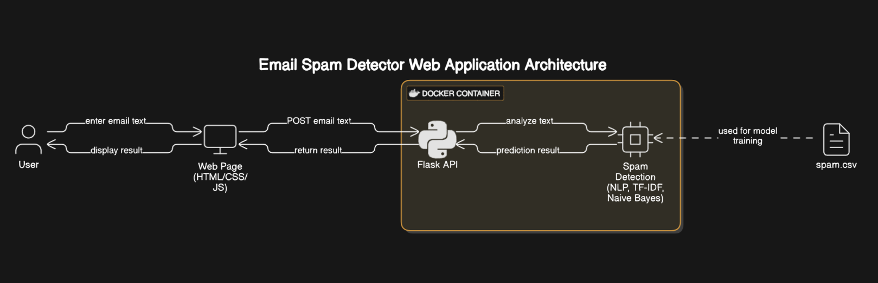
Architecture Diagram
Architecture Diagram

Slide 7
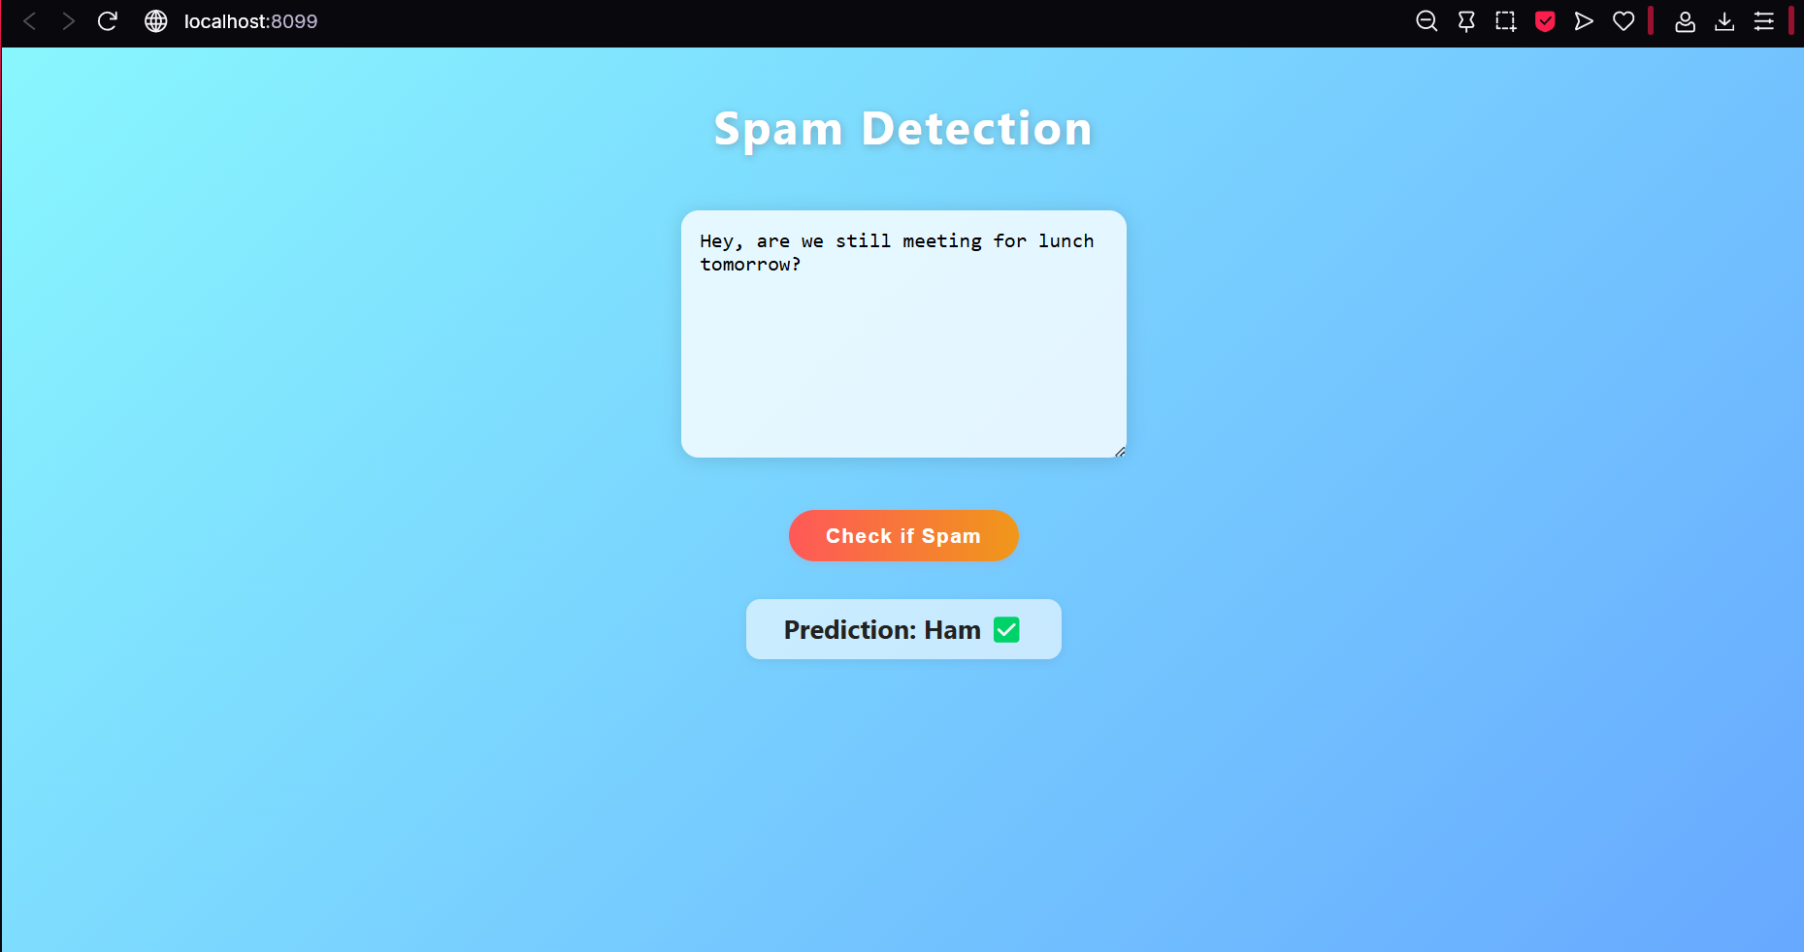
Final Result Analysis / Output

Slide 8
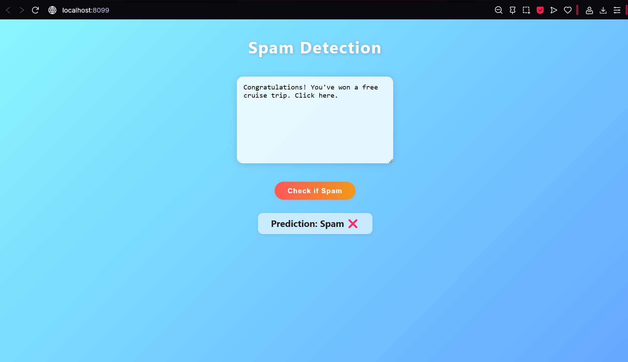
Final Result Analysis / Output

Slide 9
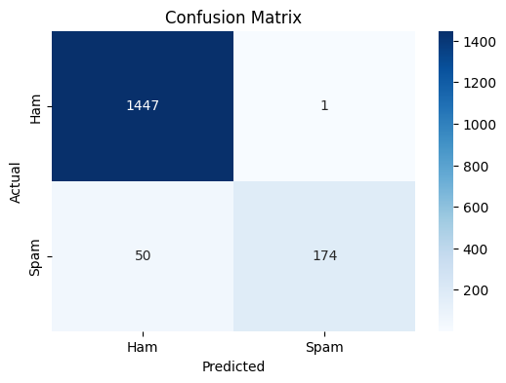
Final Result Analysis / Output

Slide 10
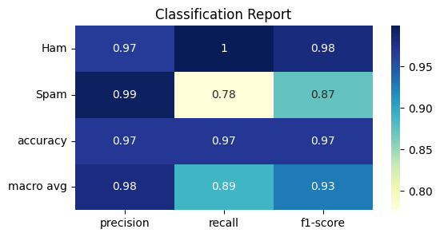
Final Result Analysis / Output

Slide 11
References
Srivastava, A., & Singh, P. (2021). Spam Detection Using Natural Language Processing. J. Appl. Sci. Educ. https://jase.a2zjournals.com/index.php/ase/article/view/70
Anonymous (2024). Email Spam Detection using Naïve Bayes Algorithm. IJRASET. https://www.ijraset.com/research-paper/email-spam-detection-using-naive-bayes-algorithm
Chavez, A. (2023). TF-IDF classification based Multinomial Naïve Bayes model for spam filtering. National College of Ireland. https://norma.ncirl.ie/4490/1/alanchavez.pdf
Bhatnagar, P., & Degadwala, S. (2024). Efficient Email Spam Classification with N-gram Features and Ensemble Learning. IJSRCSEIT. https://ijsrcseit.com/index.php/home/article/view/CSEIT2410220
Borotić, G., et al. (2023). Effective Spam Detection with Machine Learning. Croatian Regional Development Journal. https://sciendo.com/pdf/10.2478/crdj-2023-0007

Slide 12
Thanks

